Slide 1
INTRODUCING COMMUNITY PSYCHOLOGY (CP)
WEEK 2

Slide 2
LEARNING OUTCOMES
By the end of this class, you should be able to:
determine the goals of CP and how different it is from other psychological fields.
recognize the interaction among all levels in ecological perspective, and how these relationships contribute towards appropriate intervention in the community.
understand how values determine actions and research which will lead to promotion of well-being.
compare and contrast between the Western and Islamic perspective of community.

Slide 3
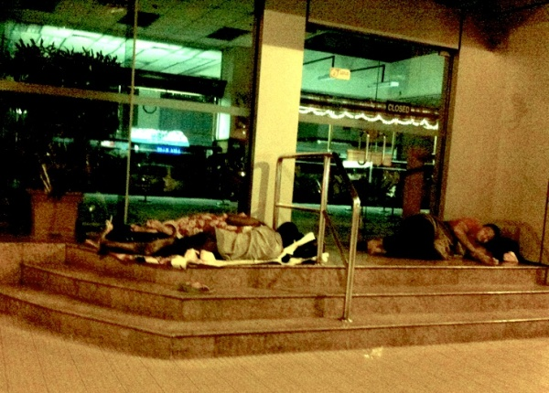
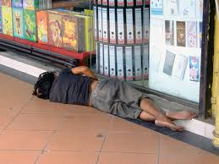
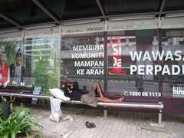
Issue of Homelessness: Malaysia

Slide 4
The Defining Features of CP
Definition: CP concerns the relationship of individuals with communities and societies.
By integrating research, it seeks to understand and enhance quality of life for individuals, communities, and societies.

Slide 5
Comparing Community Psychology with applied psychology
Assumptions
Traditional Applied Psychology
Community Psychology
Levels of Analysis
Problem definition
Role of Professional
Focus of Intervention
Goals of Intervention
Interdisciplinary Ties
Intrapersonal
Based on individualist philosophies that blame victims
Expert
Deficit/Problems
Remedial (Late)
Psychiatry/Clinical Social Work
Ecological
Problems are reframed in terms of social context and cultural diversity.
Research Collaborator
Competence/Strength
Prevention (Early)
Law, social work, political science

Slide 6
The persons, context & change
Context minimization error: ignoring the importance of contexts in an individual’s life.
  Lead to flawed psychological theories and research findings.
  Lead to failure in therapy interventions (i.e., homeless people).
Context: the encapsulating environments within which an individual lives
  i.e., family, friendship network, neighbourhood, workplace
  Make up the structural forces that shape the lives of individuals.
CP is about the relationships of persons and contexts.

Slide 7
The work of a Community Psychologist
Helping beyond the traditional psychotherapy to promote wellness;
Engage in action oriented research to develop, implement and evaluate programs;
Build collaborative relationships with community members, groups, and organizations to solve social problems; and
Work as educators, professors, program directors, consultants, and researchers to promote mental health and community well-being.

Slide 8
Ecological Levels of Analysis
Ecological levels in CP are used:
  to clarify different values, goals, and strategies for intervention;
  to focus on the interactions between system; and
  to clarify how a single event or problem has multiple causes (i.e., homelessness)

Slide 9
Discussion
What is Bronfenbrenner’s ecological theory?
Summarize the theory.
Discuss the strengths and weaknesses of the theory.

Slide 10
Bronfenbrenner (1996)
Microsystems: familes, classrooms, workgroups, friendships.
Organizations: schools, religious congregations.
Localities: Neighbourhood, towns, cities, rural areas.
Individuals
Macrosystems: Governments, cultures, societies

Slide 11
Levels of Intervention
What to change?
How to change?
Mediating structures:
  Society can exert stressful conditions on individuals.
  Focuses on settings that can assist individuals coping with these stressors.
    Organizations (e.g., schools or mutual help group).

Slide 12
Debriefing
CP concerns the relationships of individuals with communities and societies.
It is different from other applied psychology in terms of levels of analysis, problem definition, role of professionals, and focus of intervention.
By integrating research with action, it seeks to understand and enhance quality of life for individuals, communities, and societies.

Slide 13
Next Class Reading
Please refer to http://psyc4260.yolasite.com/ for notes:
Ali, R., Jamoul, L., & Vali, Y. (2012). A New Covenant of Virtue: Islam and Community Organising. Cavell Street, London
Integration of Multicultural Society: Islamic Perspective Link: http://www.ipedr.com/vol42/024-ICKCS2012-K10014.pdf

